Slide 1

Global Marketing
Chapter 1
Global Marketing
Warren J. Keegan Mark C. Green

Slide 2
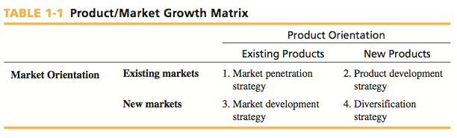
INTRODUCTION
Global vs. “Regular” Marketing
  - Scope of activities are outside the home-country market

Slide 3
GLOBAL MARKETING
Create value for customers by improving benefits or reducing price
  Improve the product
  Find new distribution channels
  Create better communications
  Cut monetary and non-monetary costs and prices
Value=Benefits/Price

Slide 4
GLOBALIZATION
“Economic globalization constitutes
integration of national economies into the
international economy through trade, direct
foreign investment (by corporations and
multinationals), short-term capital flows,
international flows of workers and humanity
generally, and flows of technology.”
~Jagdish Bhagwait~

Slide 5
GLOBAL INDUSTRIES
An industry is global to the extent that a company’s industry position in one country is interdependent with its industry position in another country
Indicators of globalization:
  Ratio of cross-border investment to total capital investment
  Proportion of industry revenue generated by all companies that compete in key world regions
  Ratio of cross-border trade to worldwide production
Coca Cola spent $5 billion worldwide on promotions and marketing in 2010

Slide 6
COMPETITIVE ADVANTAGE, GLOBALIZATION
& GLOBAL INDUSTRIES
Focus
  Concentration and attention on core business and competence
  “Nestle is focused: We are food and beverages. We are not
  running bicycle shops. Even in food we are not in all fields.
  There are certain areas we do not touch…We have no soft
  drinks because I have said we will either buy Coca-Cola or
  we leave it alone. This is focus.”
  ~Helmut Maucher, former chairman of Nestlé SA~

Slide 7
GLOBAL MARKETING: What It Is & What It Isn’t
Single Country Marketing Strategy
Target Market Strategy
Marketing Mix
  Product
  Price
  Promotion
  Place
Global Marketing Strategy
Global Market Participation
Marketing Mix Development
  4 P’s: Adapt or Standardize?
Concentration of Marketing Activities
Coordination of Marketing Activities
Integration of Competitive Moves

Slide 8
STANDARDIZATION vs. ADAPTATION
Globalization (Standardization)
  Developing standardized products marketed worldwide with a standardized marketing mix
  Essence of mass marketing
Global localization (Adaptation)
  Mixing standardization and customization in a way that minimizes costs while maximizing satisfaction
  Essence of segmentation
  Think globally, act locally

Slide 9
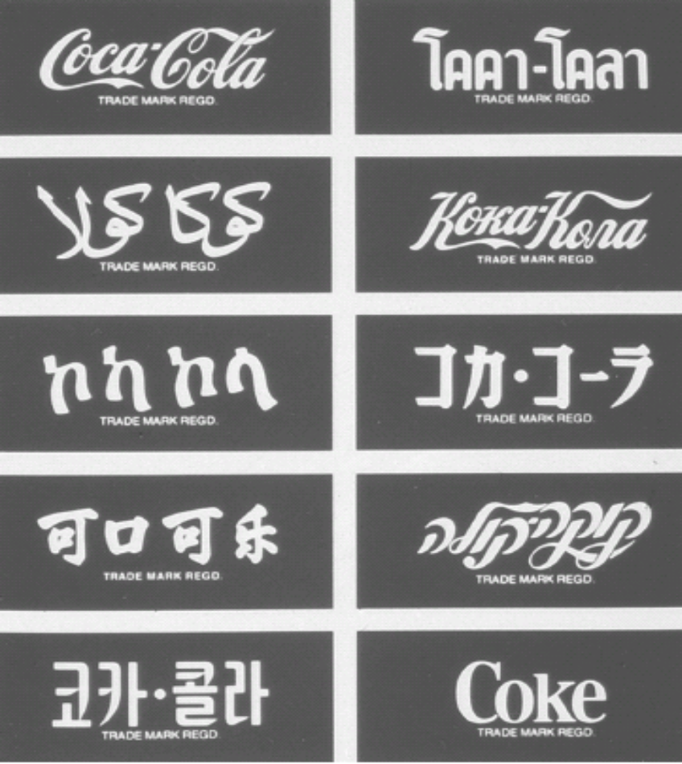
STANDARDIZATION vs. ADAPTATION
The Faces of Coca-Cola Around the World
Arabic
Read right to left
Chinese
“delicious/happiness”

Slide 10
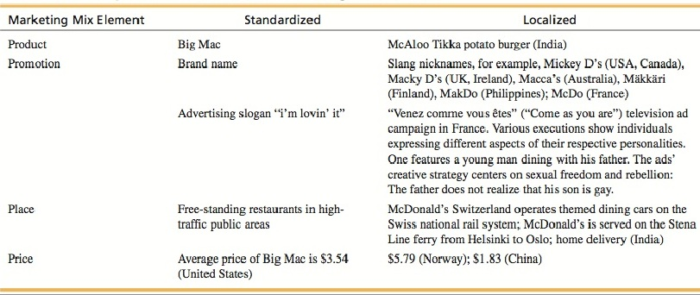
McDonald’s Global Marketing

Slide 11
The Importance of Going Global
For U.S. companies, 75% of total world market for goods and services is outside the country
  Coca-Cola earns 75% of operating income and 2/3 of profit outside of North America
For Japanese companies, 90% of world market is outside the country
94% of market potential is outside of Germany for its companies even though it is the largest EU market

Slide 12
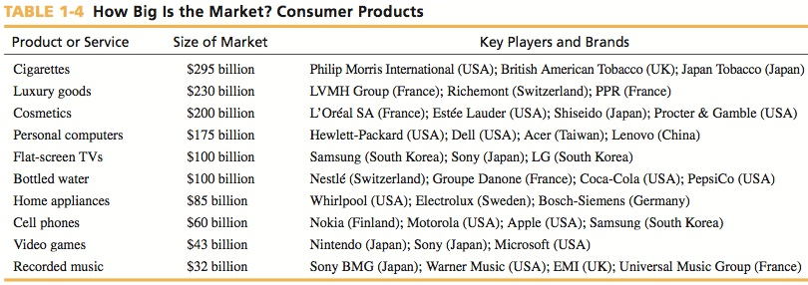
How Big Is The Global Market?

Slide 13
Management Orientations
Ethnocentric Orientation
  Home country is superior to others
  Sees only similarities in other countries
  Assumes products and practices that succeed at home will be successful everywhere
  Leads to a standardized or extension approach

Slide 14
Management Orientations
Polycentric Orientation
  Each country is unique
  Each subsidiary develops its own unique business and marketing strategies
  Often referred to as multinational
  Leads to a localized or adaptation approach that assumes products must be adapted to local market conditions

Slide 15
Management Orientations
Regiocentric Orientation
  A region is the relevant geographic unit
    Ex: The NAFTA or European Union market
  Some companies serve markets throughout the world but on a regional basis
    Ex: General Motors had four regions for decades
European Union

Slide 16
Management Orientations
Geocentric Orientation
  Entire world is a potential market
  Strives for integrated global strategies
  Also known as a global or transnational company
  Retains an association with the headquarters country
  Pursues serving world markets from a single country or sources globally to focus on select country markets
  Leads to a combination of extension and adaptation elements

Slide 17
Forces Affecting Global Integration & Global Marketing
Multilateral trade agreements
Converging market needs and wants and
the information revolution
Transportation and
communication improvements
Product development costs

Slide 18
Driving Forces Affecting Global Integration and Global Marketing
Quality
  R&D as a percent of sales
World economic trends
  2008 global crisis
  Growing middle class in China, India, Brazil, etc.
  Rapid growth in China pre-2008
  Movement to free markets worldwide

Slide 19
Driving Forces Affecting Global Integration and Global Marketing
Leverage
  Experience transfers
  Scale economies
  Resource utilization
  Global strategy

Slide 20
Restraining Forces Affecting Global Integration and Global Marketing
Management myopia
Organizational culture
National controls
Opposition to globalization

